Slide 2
ManageEngine
A division of Zoho Corporation, a bootstrapped, private, and profitable company
18+ years of
IT management solutions expertise
180,000+
customers
2,500+ employees
90+ products & free tools for IT management
190+
countries

Slide 3
The common
challenges
faced by IT asset
management teams

Slide 4
Inability to maintain a composite asset inventory
Difficulty in tracking IT asset life cycles
Lack of a streamlined purchase and contract management process
Failed license
compliance audits
Isolation of ITAM from IT service management (ITSM) processes
Insufficient data to aid strategic decision making

Slide 5
Asset Management
With
The all-in-one ITAM solution

Slide 6
Why
AssetExplorer?

Slide 7
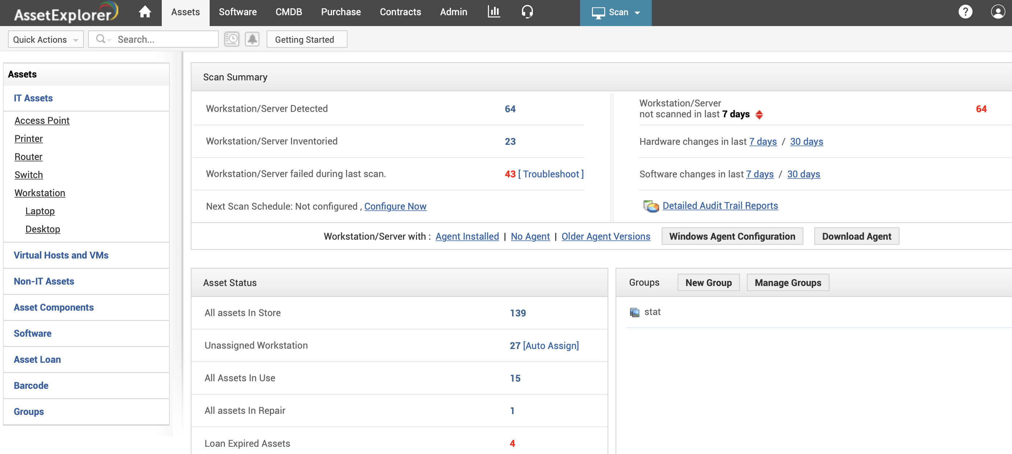
1
A single source of truth about the IT infrastructure with all the hardware & software assets enabled through multi-source discovery

Slide 8
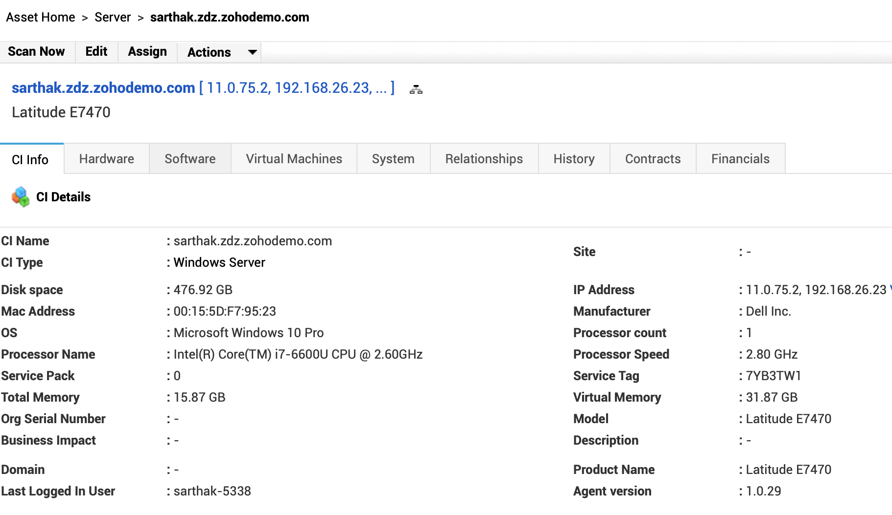
2
Complete control over the assets throughout the life cycle from procurement through disposal with custom asset statuses along with the ability to track ownership and auto-assign owners

Slide 9
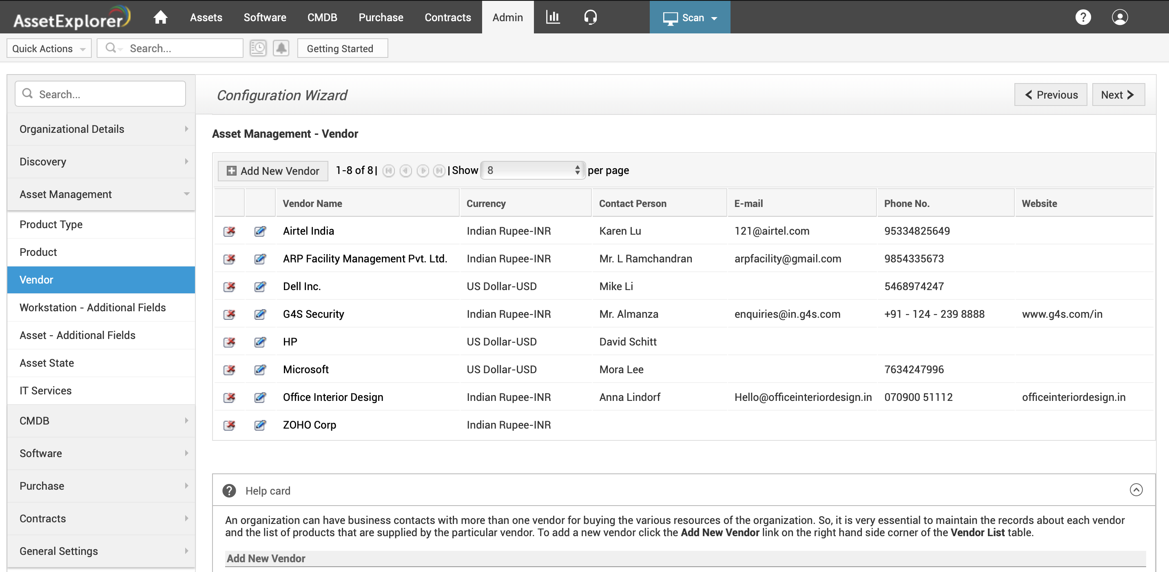
3
Ability to maximize ROI on vendor relationships with a vendor catalog, and associate the products supplied by each vendor with pricing, warranty, and maintenance details

Slide 10
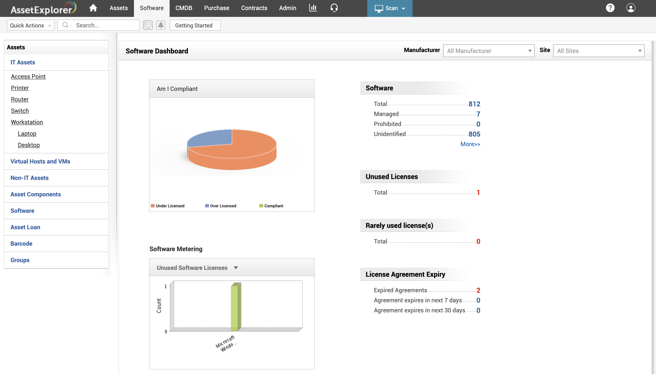
4
High software license compliance rates and lower risk of audit violations through built-in software license management with real-time software license metering and compliance dashboards

Slide 11
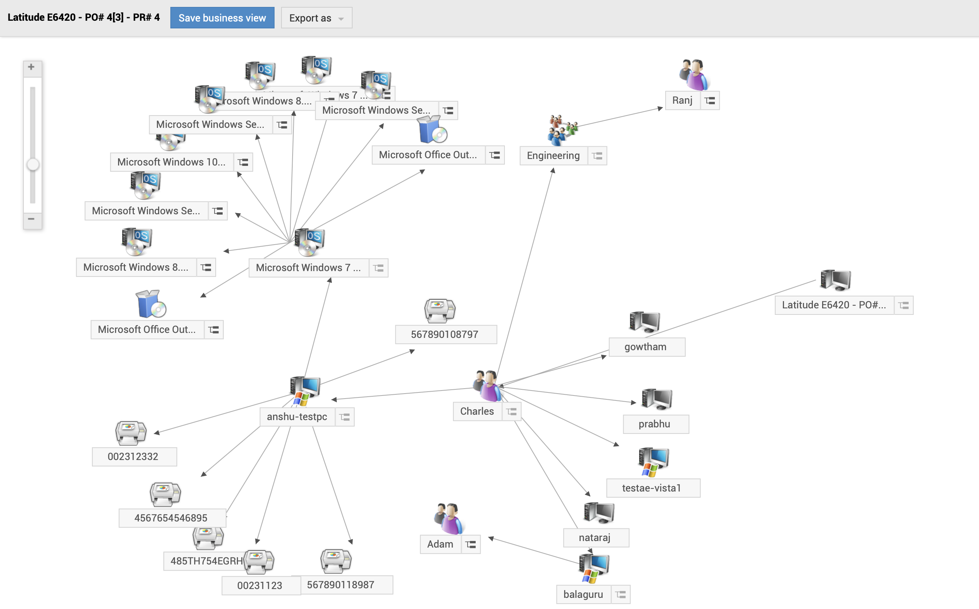
5
Reduced risks with proper impact analysis of incidents and changes through a visual map of all the dependencies and relationships between various assets built on a configuration management database (CMDB)

Slide 12
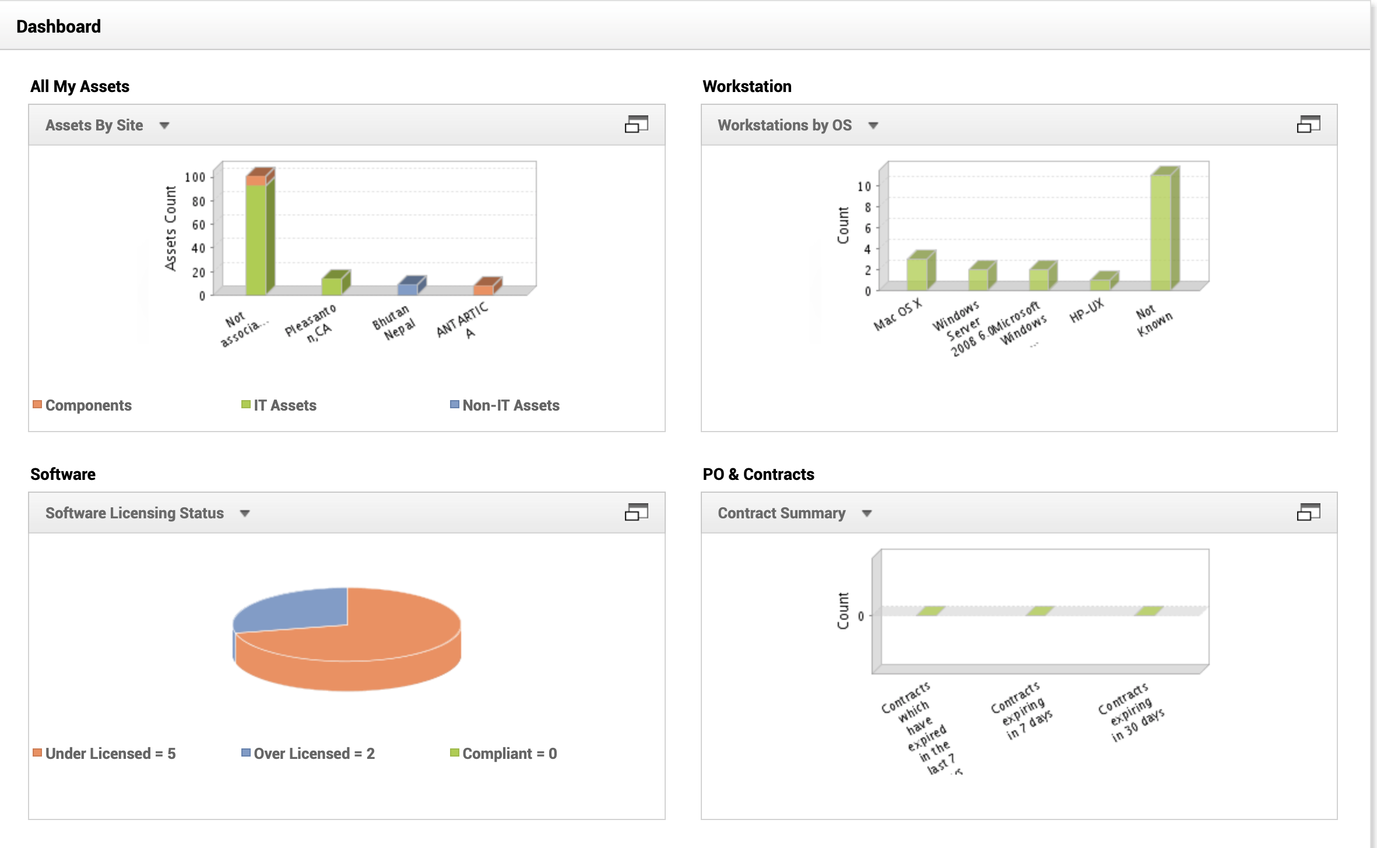
6
Easy access to real-time IT asset metrics via hardware and software dashboards, which provide the overall picture of all asset-related metrics including over licensed, under licensed, and compliant software details

Slide 13
Top ITAM capabilities
Multi-source asset discovery
Scheduled asset scans
Real-time hardware and software asset dashboards
Software license management and metering
Software asset management
Purchase order management
Asset life cycle management
IT asset inventory management
Configuration management database (CMDB)
Native Microsoft System Center Configuration
Manager(SCCM) integration

Slide 14
Editions
Free
Trial
Professional
All functionality
Free edition never expires
Restricted to 25 nodes
Available in 29 languages
24x5 live technical support
Fully functional
Fully functional
Valid until license expires
Manage nodes based on
30-day trial
Valid up to 30 days
Restricted to 250 nodes
Available in 29 languages
24x5 live technical support
the purchased license
Available in 29 languages
24x5 live technical support

Slide 15
Supported databases, browsers, & OSs
Windows Server 2012-2016
Windows 7/8/10
RHEL 8 and above
Ubuntu 14.0 and above
MSSQL 2019, 2017, 2016
MSSQL 2014, 2012, 2008
PostgreSQL
Internet Explorer: IE11, IE Edge
Firefox
Google Chrome

Slide 16
Customers

Slide 17
Asset Explorer named the
best enterprise ITAM software of 2019
by

Slide 18
How
AssetExplorer
enables best practice ITAM for support operations

Slide 19
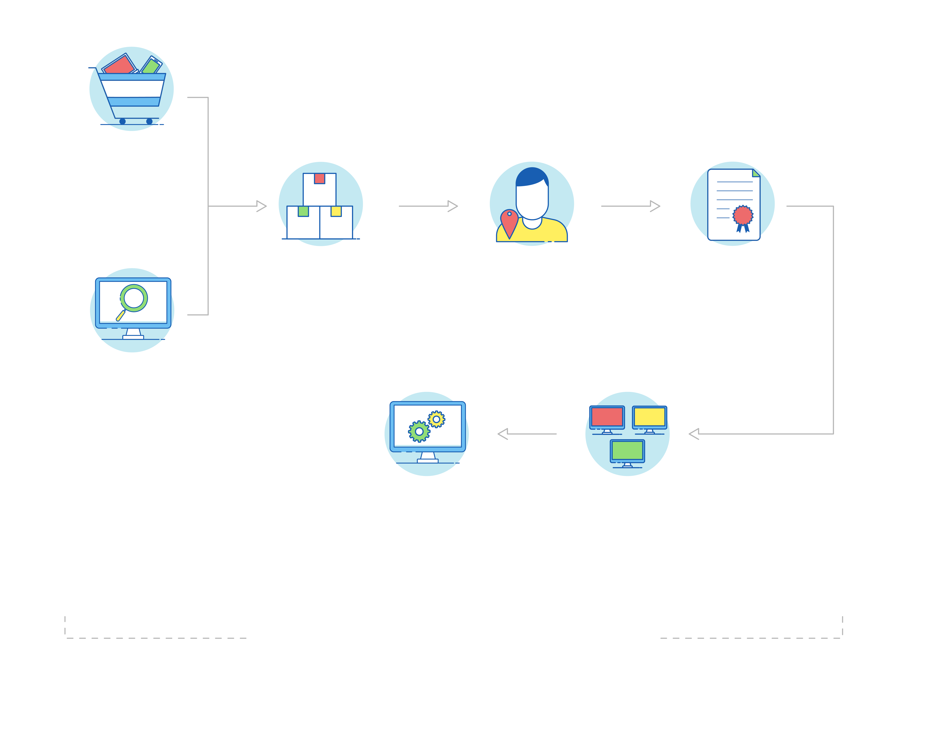
Asset management workflow
Purchase new
asset
Build asset
inventory
Map assets to users loan assets
SAM
Licensing
Metering
Service packs
Associate purchase
And contracts
Scan
Network scan
Windows domain scan
Distributed asset scan
Barcode scanning
Support other
ITIL processes
Build CI Relationships
Incident management
Project management
Change management
Change asset status | Trigger expiry notifications

Slide 20
Best practice asset management
with AssetExplorer
Gain control over all hardware and software inventory
Manage all your software license investments
Track assets across their life cycle from requisition to retirement, along with ownership
Multi-source discovery modes (Agents, Windows/network/ distributed scans)
Barcode-based discovery
Asset types
Product types
Asset states | User-workstation mapping | Asset loans

Slide 21
Best practice asset management
with AssetExplorer
Keep track of asset depreciation and other costs
Classify asset and product types
Map relationships between assets and business services
Software, license, and agreement types
Depreciation | Cost center | GL codes
CMDB | CI types
CI relationships
Business views

Slide 22
Best practice asset management
with AssetExplorer
Track software usage and compliance
Stay on top of your IT purchases
Centralize the asset contracts management process
Asset states
User-workstation mapping | Asset loans
Purchase management
Vendor list | Approvals
Invoice and payment
Associated assets
Contract details | Renewal details | Child contracts
Expiry notifications
Associated assets

Slide 23
Reporting in
AssetExplorer

Slide 24
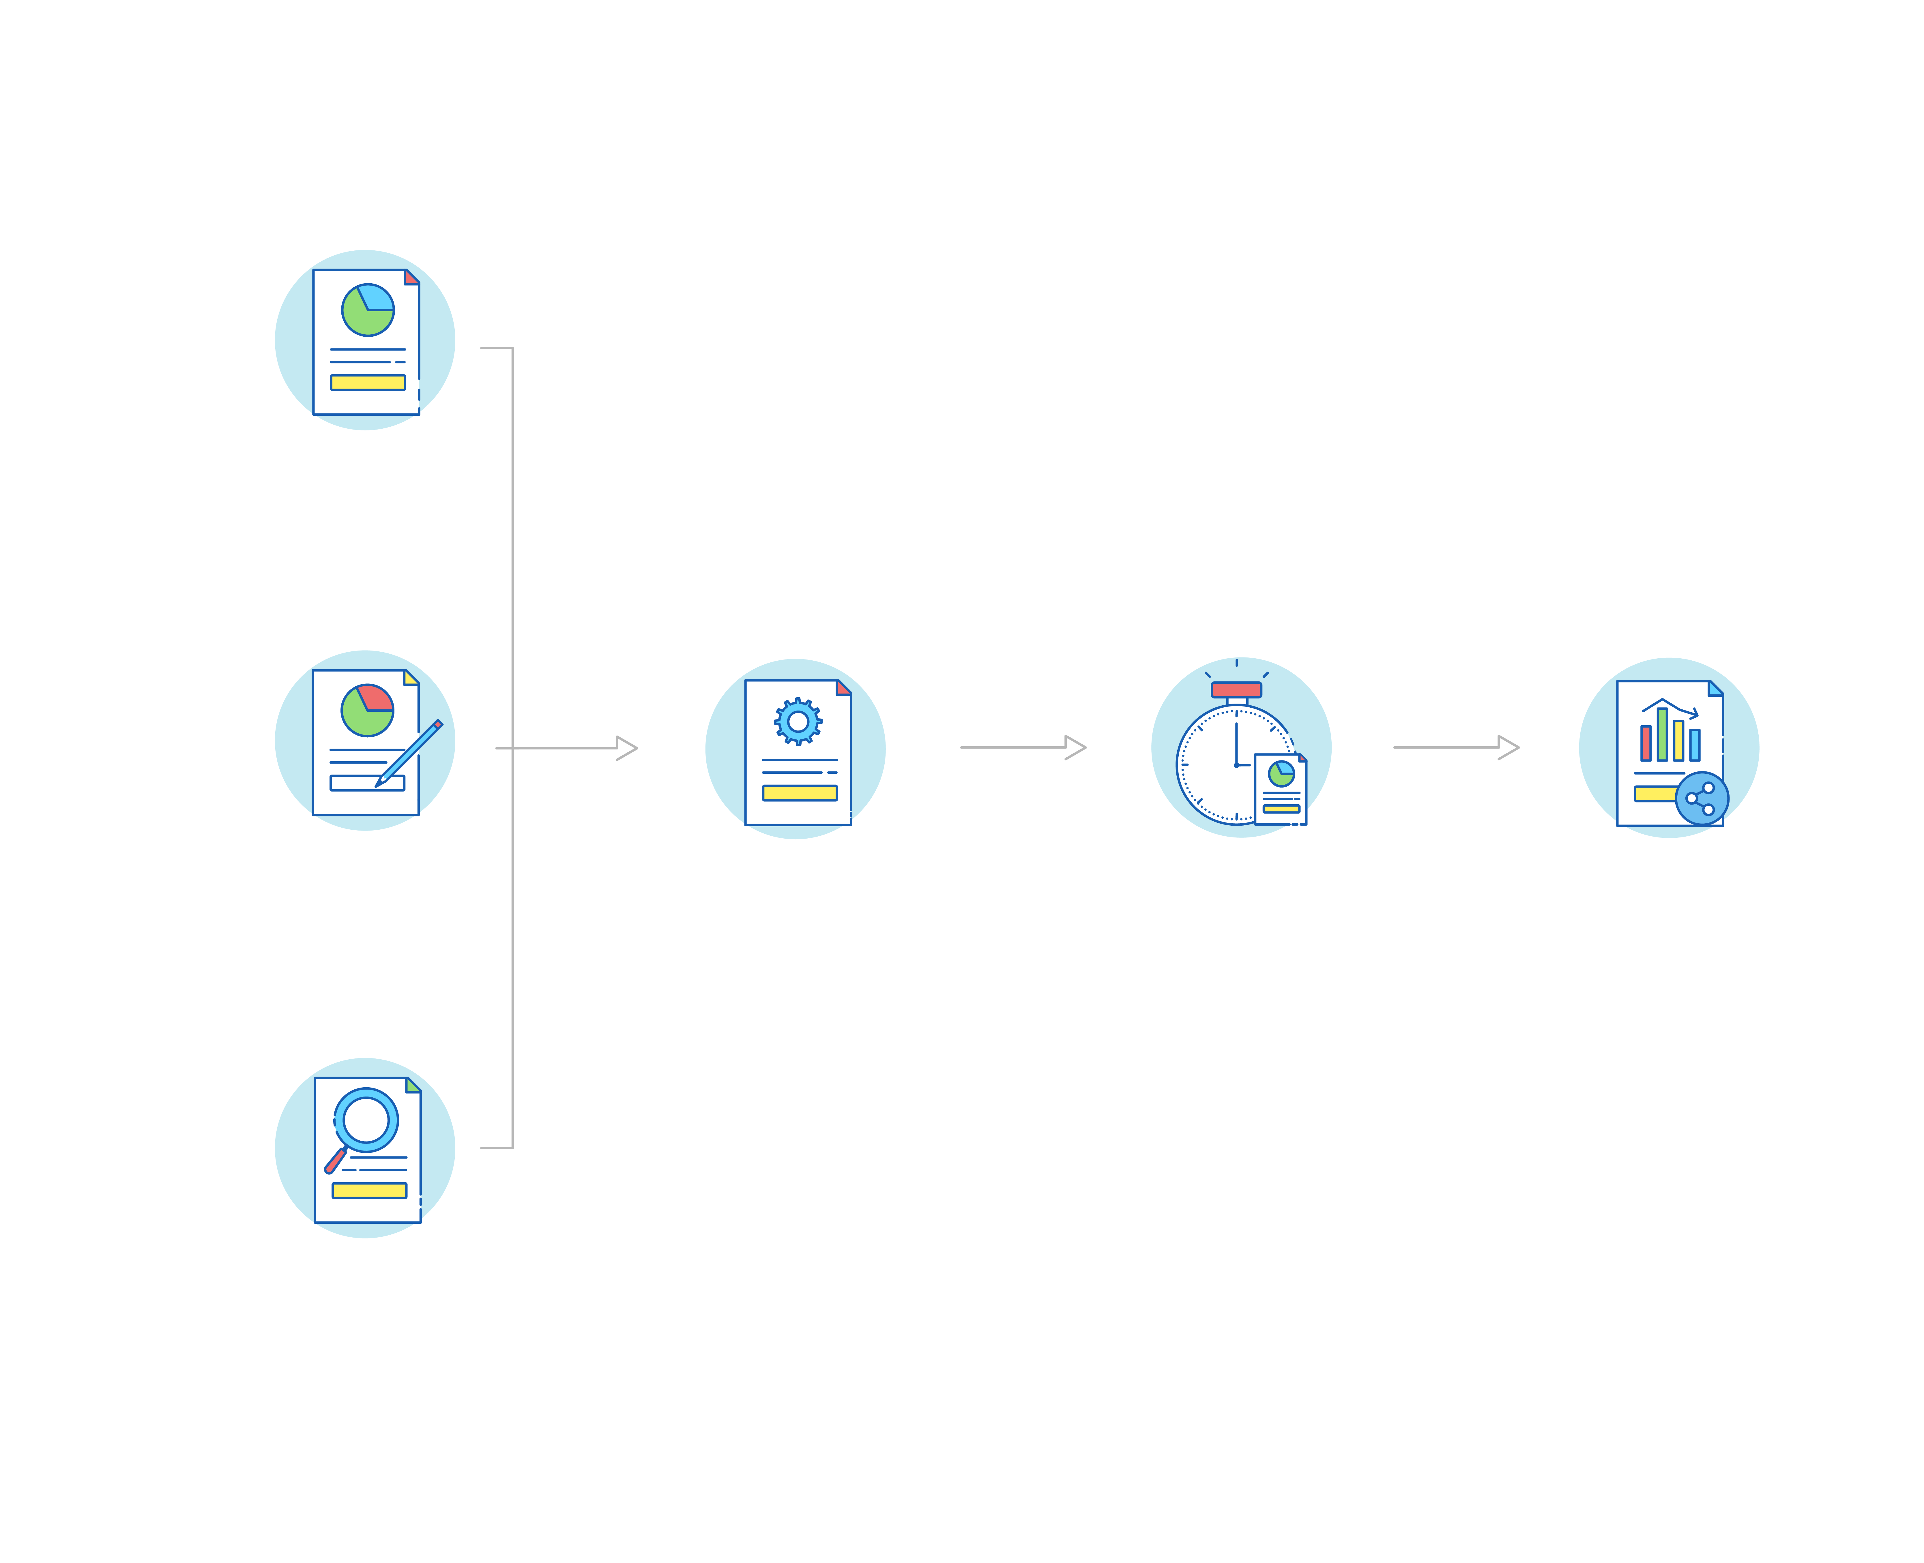
Reporting in Asset Explorer
Pre-defined
reports
Customizable
reports
Generate &
share reports
Schedule
reports
Configure &
modify reports
Email as HTML,XLS,CSV and PDF | Customize dashboard
Knowledge
base
Report type, Choose desired data, Filter options,
Save reports
Query
reports

Slide 25
Best practice reporting
in AssetExplorer
Keep tabs on your key service desk metrics
Keep key stakeholders and CXOs informed periodically
Mine information about your service desk from the available data
Out-of-the-box reports Live dashboards Custom dashboard widgets
Scheduled reports
Email reports automatically
Export reports as HTML, PDF, XLS, and CSV files
Custom reports (tabular, matrix, summary, and audit reports) | Query reports | Custom CI reports

Slide 26
‌www.assetexplorer.com
‌sales@manageengine.com

